Slide 1
Virginia Tax
Overview of New Hire Forms
January 2026

Slide 2
Welcome to Virginia Tax
Congratulations on your new job! We’re excited for you to join us.
Please review these instructions on completing the 6 new hire forms you will need to bring with you on your first day.
You will also need to bring supporting documentation with you – there is more information about what’s required in later slides.
We look forward to meeting you!

Slide 3
Forms Covered
I-9 (supporting documents required)
W-4 and VA-4
Direct Deposit Authorization (supporting documents required)
Personal Information and Emergency Contact
Prior State Service

Slide 4
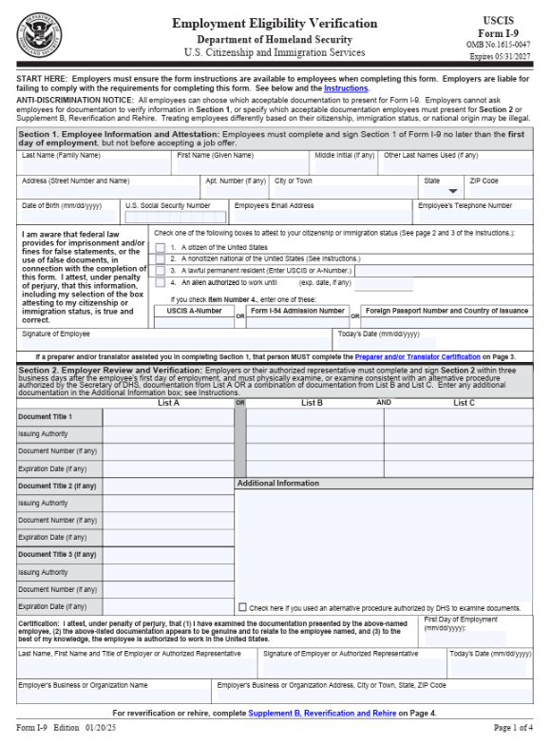
I-9
The I-9 form verifies your identity and right to work.
Complete Section 1 only.
Human Resources will complete Section 2.

Slide 5
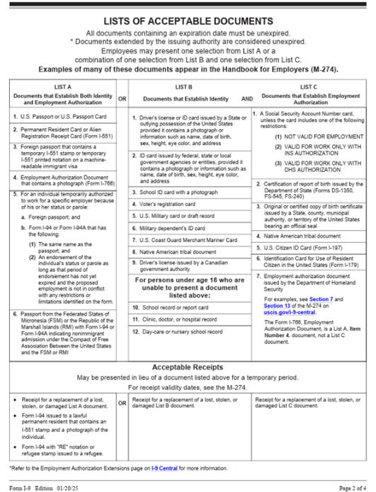
I-9
Required Supporting Documents:
1 document from List A
OR
1 document from List B AND 1 document from List C

Slide 6
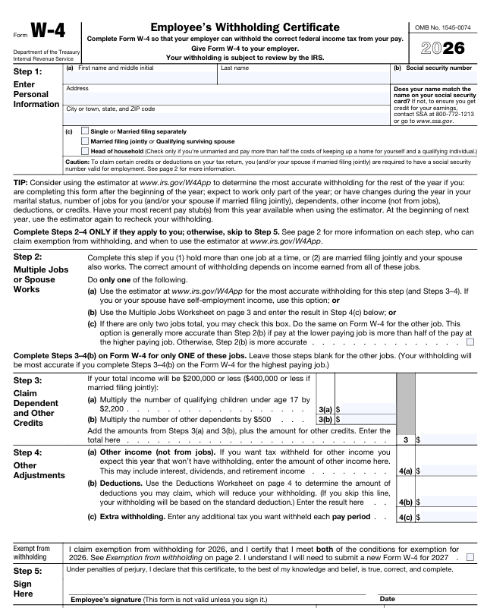
W-4
Federal Withholding Certificate
Steps 1 and 5 are required.
Steps 2-4 are optional:
  Multiple jobs or spouse works
  Claim dependents
  Other adjustments

Slide 7
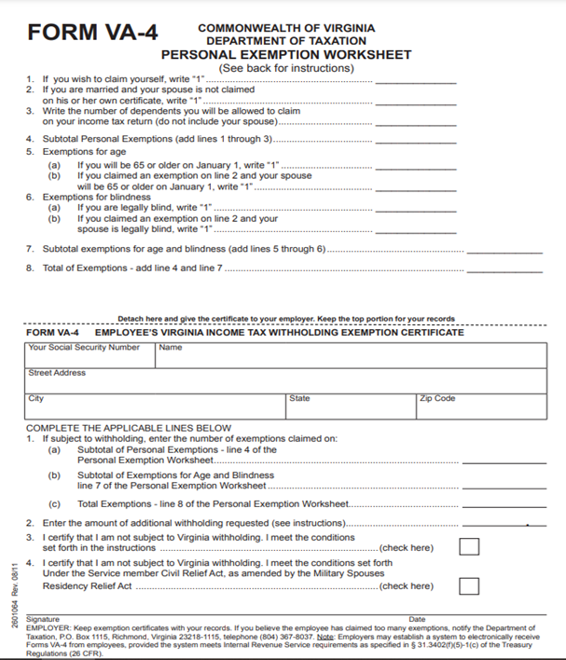
VA-4
Commonwealth Withholding Certificate
You may use the top worksheet to assist in completing this form.
Lines 1 and 2 are required
If you don’t want additional withholding on Line 2, enter 0.00.
Lines 3 and 4 are optional.

Slide 8
Employee Direct Deposit
You will receive a direct deposit authorization form on your first day.
You will need to bring documentation to set up direct deposit:
Voided check with your name on the account
OR
Letter from your bank with your routing and account numbers

Slide 9
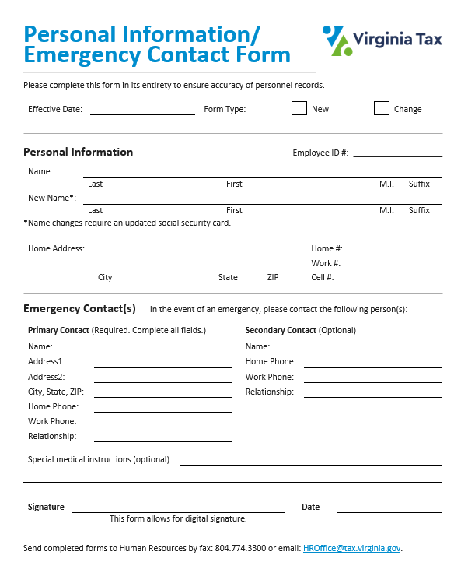
Personal Information/Emergency Contact
Provide contact information and any special medical instructions.
Primary emergency contact is required – complete all fields for your primary contact.

Slide 10
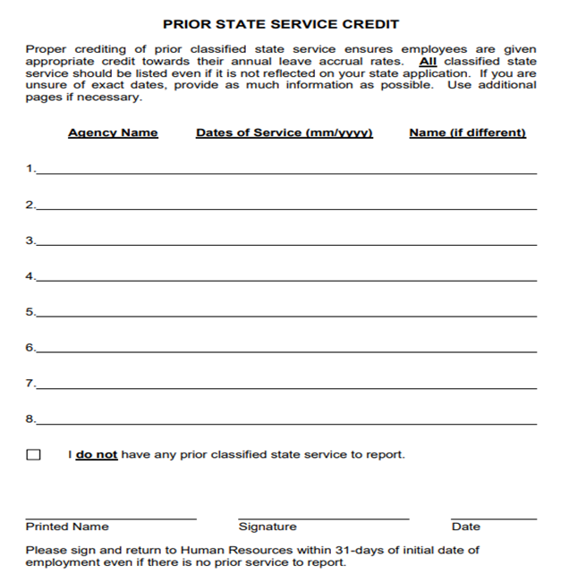
Prior State Service
This form is required for all new hires.
If you don’t have prior state service, check the box indicating you don’t have any state service to report.

Slide 11
Thank You
If you have any questions, please contact
Human Resources at 804.786.3608.

